Slide 1
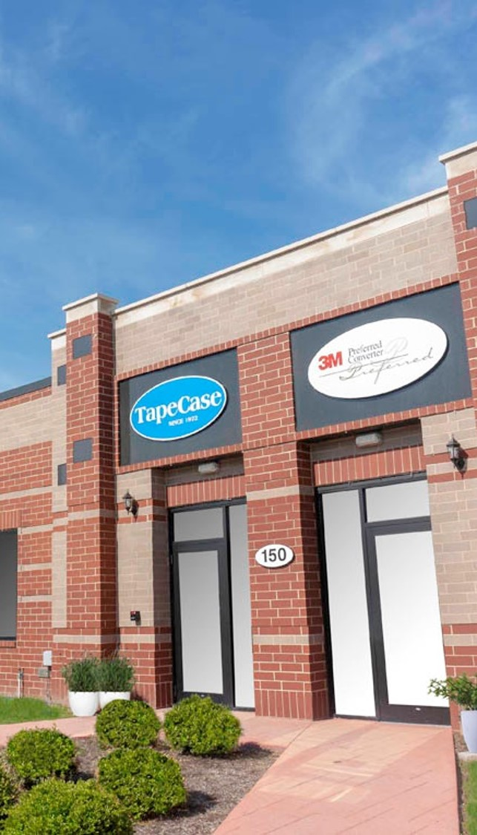
Custom Adhesive Solutions, Case by Case

Slide 2
Company Overview
Established 1972
Located in
Elk Grove Village, IL
Wholesale Converted Tapes
ISO 9001:2015 Certified

Slide 3
TapeCase Distributor Service Model
01.
02.
Custom Solutions for Multiple 3M Product Needs
Over 1000 Products In Stock, including 3M Tapes & Abrasives!
Sizes, Configurations, Low Minimums, Custom Packaging, Private Branding
In Stock Standard SKUS, Fast Quotes & Short Lead Times
03.
04.
Over 50 Pieces of Converting Equipment
Value Add Services: Private Branding
Jumbo Inputs, Slitting, Rewinding, Die Cutting, Prototyping, Production Runs, Printing
Develop your own offerings of branded tape and label products.

Slide 4
Maximizing the Program
When should I consider using a TapeCase solution to close business?
Purchase from TapeCase when customer needs
Purchase from 3M when customer wants
Non-standard sizes or formats
Less than case quantities
Need shorter lead times
Standard roll sizes
Full case quantities
Standard lead time acceptable

Slide 5
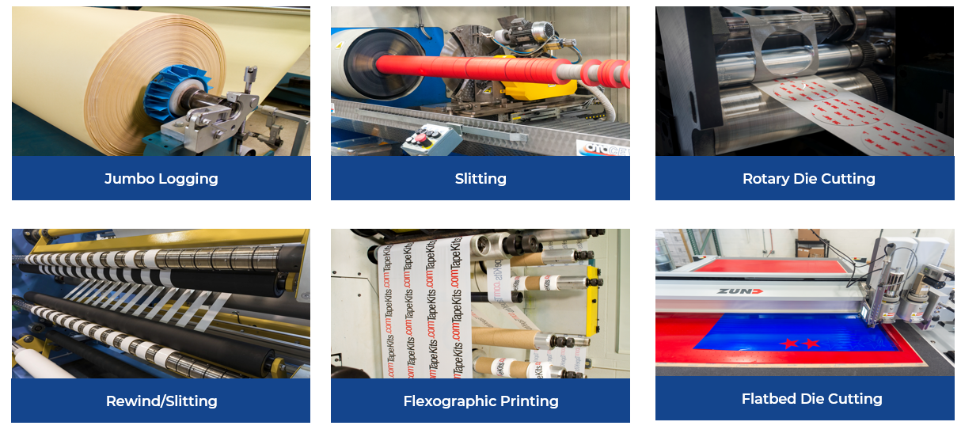
TapeCase Tape Converting Capabilities
Jumbo Logging
Slitting
Rotary Die Cutting
Rewind/Slitting
Flexographic Printing
Flatbed Die Cutting

Slide 6
Tapes Carried
Bonding Tapes
Sound and Vibration Damping Foam Gaskets
Conspicuity & Reflective Tapes
Adhesive Transfer
Double Coated Film and Foam
VHB
5 & 10 Year Warranty
Colors
EAR ISOLOSS
EAR ISODAMP
EAR CONFOR

Slide 7
Tapes Carried
Electronic Component Tapes
Specialty Tapes
Medical – Stick to Skin Tapes
Thermal Management Pads/Tapes
EMI/RFI Shielding
Water Contact Indicator
Insulating Kapton & Polyimide
UHMW and PTFE Tapes
High Temperature Masking Tape
Polyester Silicone Splicing Tapes
Reclosable Fasteners
Double Sided / Single Sided
Nonwoven, Films, Foams

Slide 8
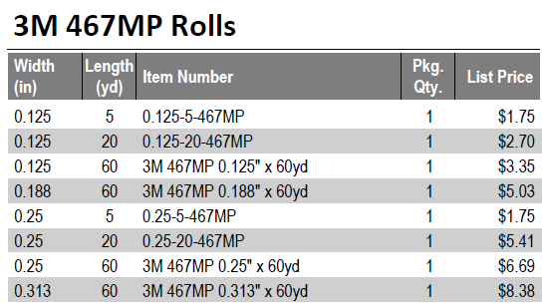
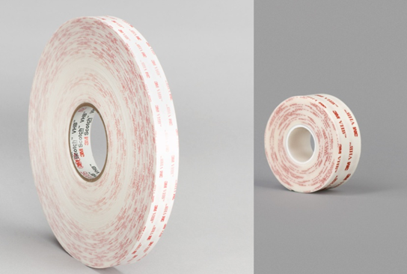
TapeCase In Stock Distributor Program
TapeCase SKU’s are NOT available from 3M directly
30,000+ SKU’s of STOCKED 3M Abrasives, Tapes & Labels
Converted tapes, printed labels and custom size belts are now a commodity
Low Minimums; (1 roll/1 pack purchases available)
No Inventory Commitment
End User Drop Shipping Available
Integration of distributor packing slips and blind shipping
We will complete YOUR TEMPLATE
24-48 Hour Lead Time on Stock TapeCase Products
EDI Capabilities
3M Supplied Roll
1” x 36 yds
4950 VHB Tape
TapeCase Supplied
1” x 5 yds
4950 VHB Tape

Slide 9
Why Converted Tapes?
Benefits of Converted Tapes
Converted Tape Applications
Sized for VMI Programs
Decreased Waste
Increase Ease of Application
Minimal Handling
Reduced Labor Hours on Assembly
Superior Accuracy of Cut Parts
Unlimited Sizes/Configurations
Assembly/Manufacturing
Bonding/Attaching
Bump, Squeak and Rattle Reduction
EMI/RFI Shielding
Fine Line/Precision Masking
Product Protection
Specialty Packaging Needs

Slide 10
Value Add Services: Private Branding
We leverage our converting capabilities to help companies develop their own offerings of branded tape and label products.
PRIVATE BRAND PROGRAM OPTIONS
Custom Printed Core
Customized Packaging
Labels
Boxes
Individual Product Wrapping
Case/Bulk Packaging
Custom Product Configurations
Rolls and Cut Parts
Industry Differentiated Product Offerings
Low Minimums Available
As low as 5 cases depending on the customization requested

Slide 11
Label Materials
TapeCase is your source for 3M Performance label materials printed with logos, safety warnings, instructions and security
information. We can also create the perfect size thermal transfer blank label for you to print on-site at your facility.
Electronic Labels
Heavy Machinery Labels
Safety Warning Labels
LED Lighting
Medical Devices
Battery Packs
Forklifts
Lawn Mowers
Printing Equipment
Electric Shock Risk
Flammable Materials
Hot Surfaces

Slide 12
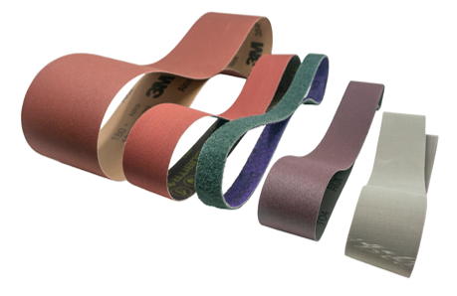
3M Abrasive Belts-to-Go Program
TapeCase Service Model
Made-to-order-sizes available through TapeCase
Size Availability | Minimum | Maximum
Width | ¼ inch | 23 inch
Length | 11 inch | 440 inch
Smaller MOQ’s
Ship in 1-3 days
Common size stock and custom made-to-order sizes available
Standard options only (e.g., standard splice, flex and edge)
Example of 3M Case Quantities vs. Tapecase minimum on Stock Belts
Product Series | Grade | Width (in) | Length (in) | 3M MOQ | TapeCase MOQ
217EA | A16 | 3 | 132 | 50 | 5
302D | P150 | 3 | 132 | 50 | 5
784F | 36+ | 3 | 132 | 25 | 3
384F | 60+ | 0.5 | 18 | 200 | 20
Durable Flex | FINE | 0.5 | 18 | 20 | 2

Slide 13
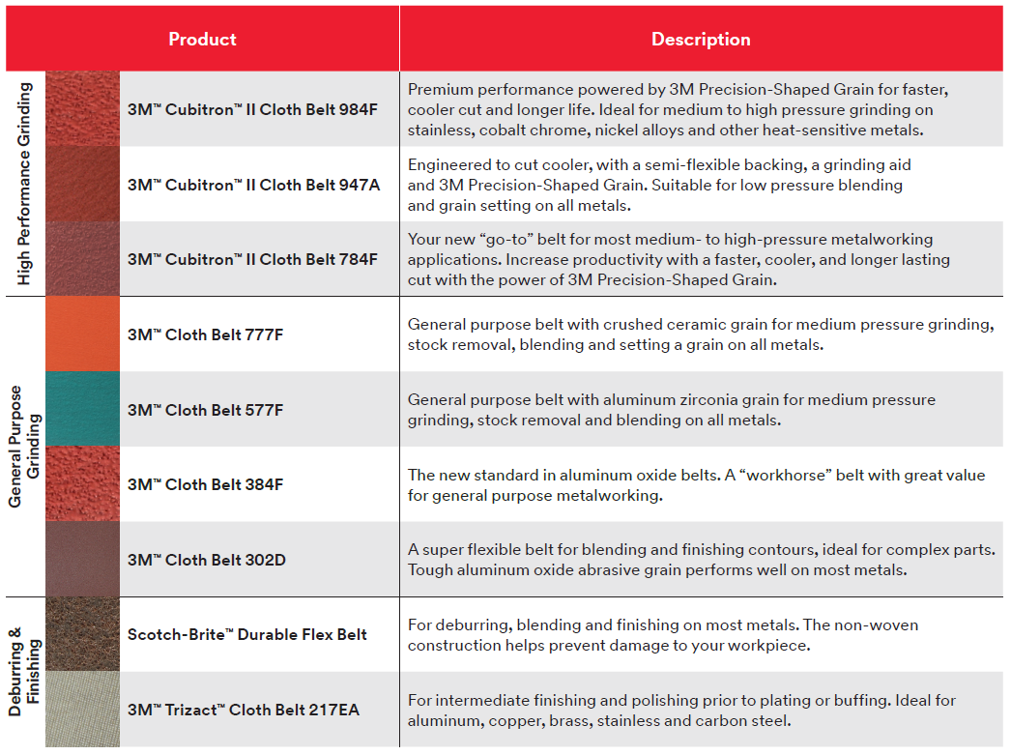
What belts are included in Belts-to-Go?

Slide 14
TapeCase Custom Product Service Model
Pricing
Low Minimums
Lead Times
Offering manufacturer wholesale prices
Low minimum order sizes and no inventory commitment
Rapid 24-48 hour lead times on stocked products

Slide 15
TapeCase Custom Product Service Model
Speed to Quote
Selection
Drop Shipping
Quick turnaround on quotes;
4 hours or less!
1000+ 3M tapes in jumbo, log roll and converted formats in stock
Can drop/blind ship orders and integrate your packing slips/ paperwork

Slide 16
3M, TapeCase and Distributor
Support of Sales Efforts and Collaboration on Marketing
National and Local Level End Users Selling
Distributor
Enhancement of 3M Products Portfolio through Channel

